Slide 1
Fair use notice
The material used in this presentation i.e., pictures/graphs/text, etc. is solely intended for educational/teaching purpose, offered free of cost to the students for use under special circumstances of Online Education due to COVID-19 Lockdown situation and may include copyrighted material - the use of which may not have been specifically authorized by Copyright Owners. It’s application constitutes Fair Use of any such copyrighted material as provided in globally accepted law of many countries. The contents of presentations are intended only for the attendees of the class being conducted by the presenter.

Slide 2
OBJECT ORIENTED PROGRAMMING
Presented by: Engr. Mariam Memon

Slide 3

Table of contents
Introducing Inheritance
Using super
Method Overriding
Dynamic Method Dispatch
Abstract Classes
Using final with Inheritance

Slide 4
Introducing inheritance
Inheritance allows you to define a very general class and then later define more specialized classes that add some new details to the existing general class definition.
Defining a new class based on an existing class is called derivation.
The new class, or derived class, is referred to as a direct subclass of the base class.
The original class is also referred to as a superclass of the derived class.

Slide 5
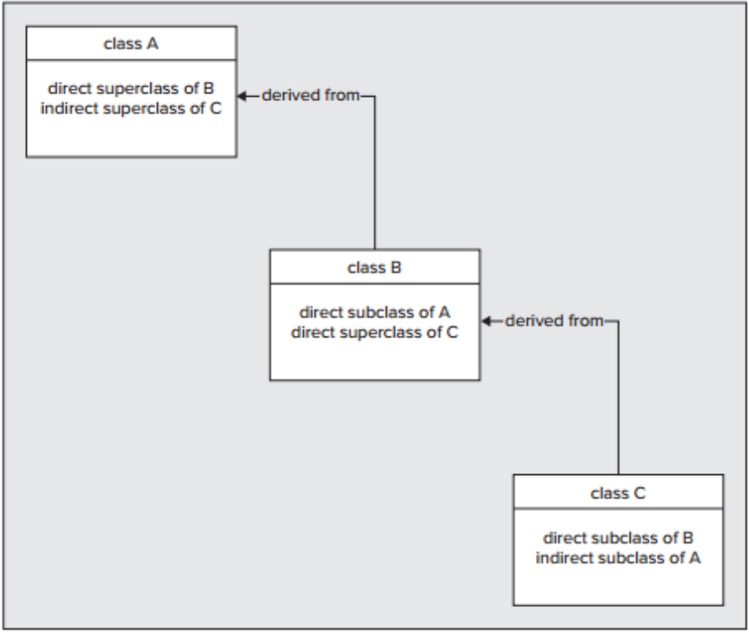
Introducing inheritance

Slide 6
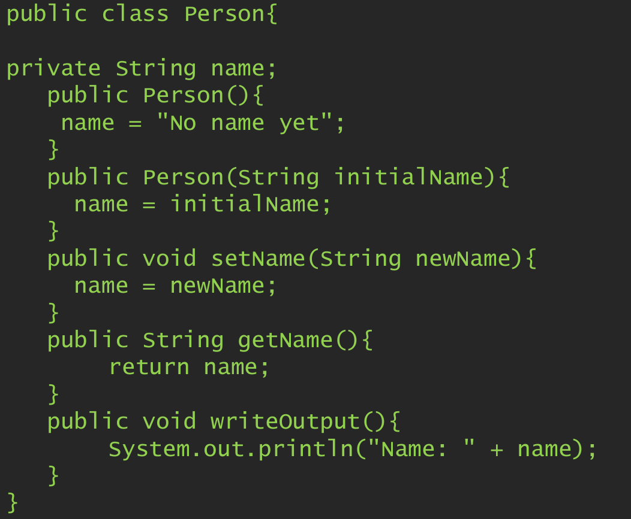
Introducing inheritance -base class

Slide 7
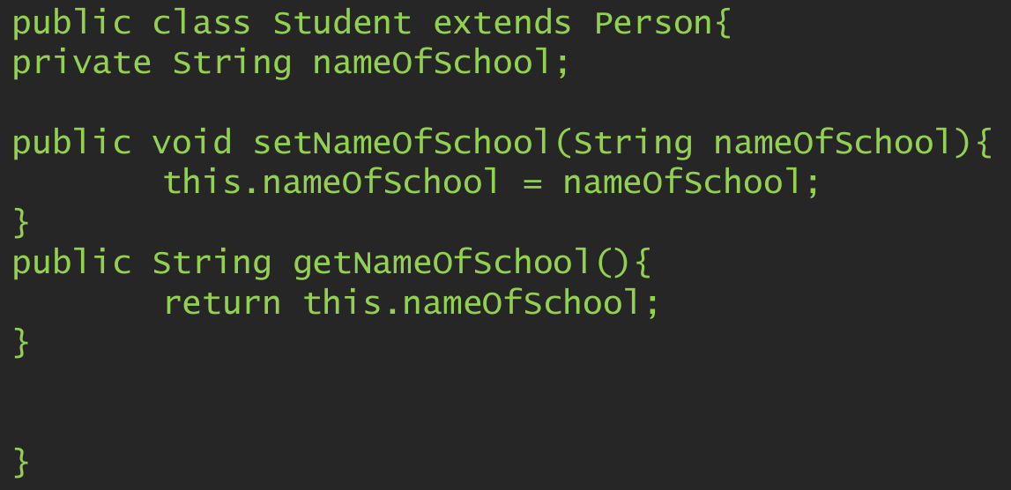
Introducing inheritance -child class

Slide 8
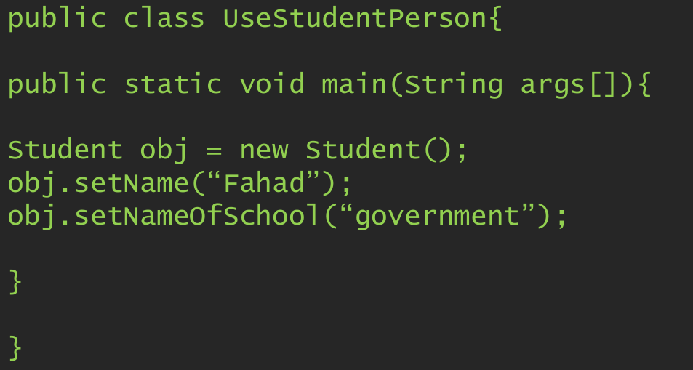
Using inherited class

Slide 9
Super keyword
Whenever a subclass needs to refer to its immediate superclass, it can do so by use of the keyword super.
super has two general forms:
The first calls the superclass’ constructor.
The second is used to access a member of the superclass that has been hidden by a member of a subclass.

Slide 10
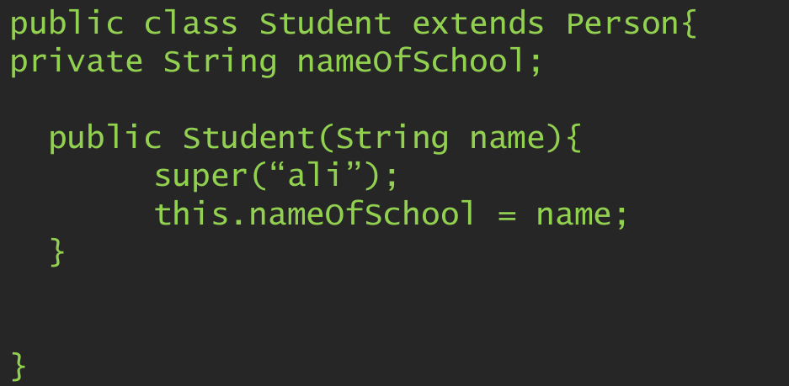
Using super keyword for superclass constructor

Slide 11
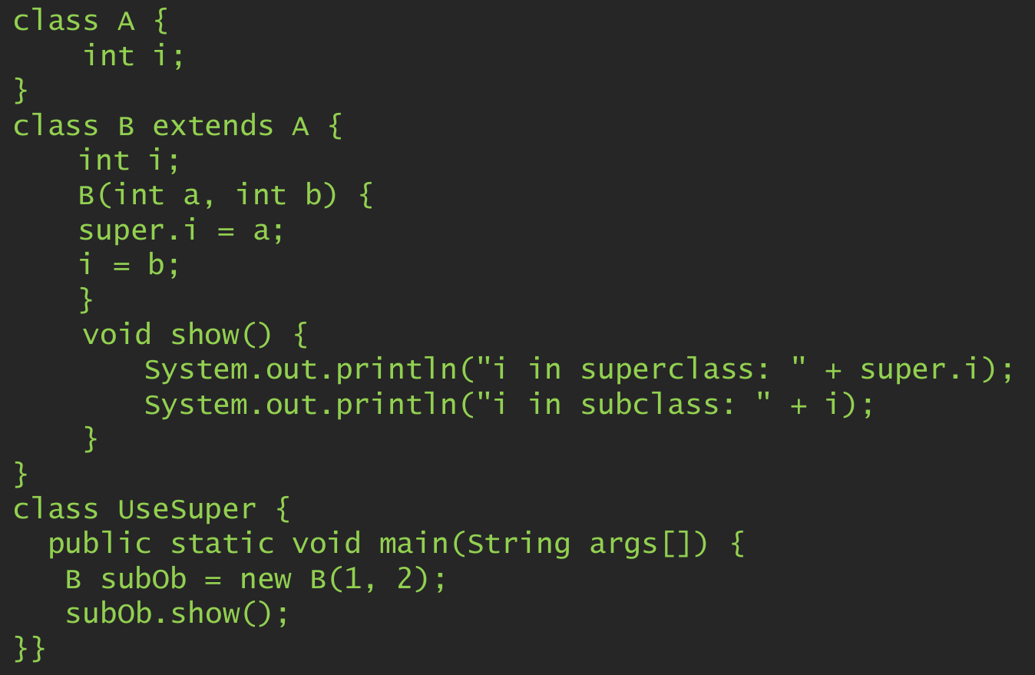
Using super keyword to refer to the object of the super class

Slide 12
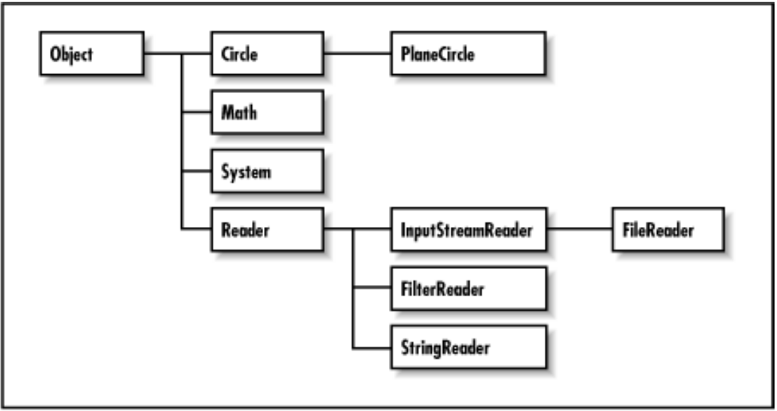
Creating a class hierarchy
Example of class hierarchy

Slide 13
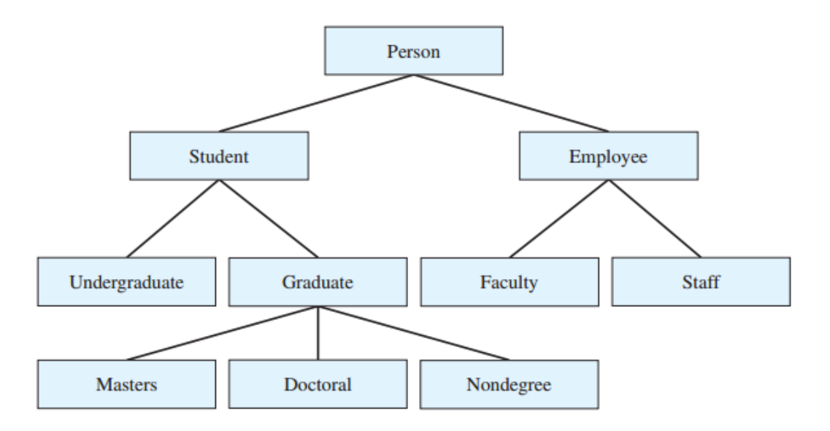
Creating a class hierarchy
Example of class hierarchy

Slide 14
Constructors in class hierarchy
In a class hierarchy, constructors are called in order of derivation, from superclass to subclass.
super( ) must be the first statement executed in a subclass
constructor, this order is the same whether or not super( ) is used.
If super( ) is not used, then the default or parameter-less constructor of each superclass will be executed.

Slide 15
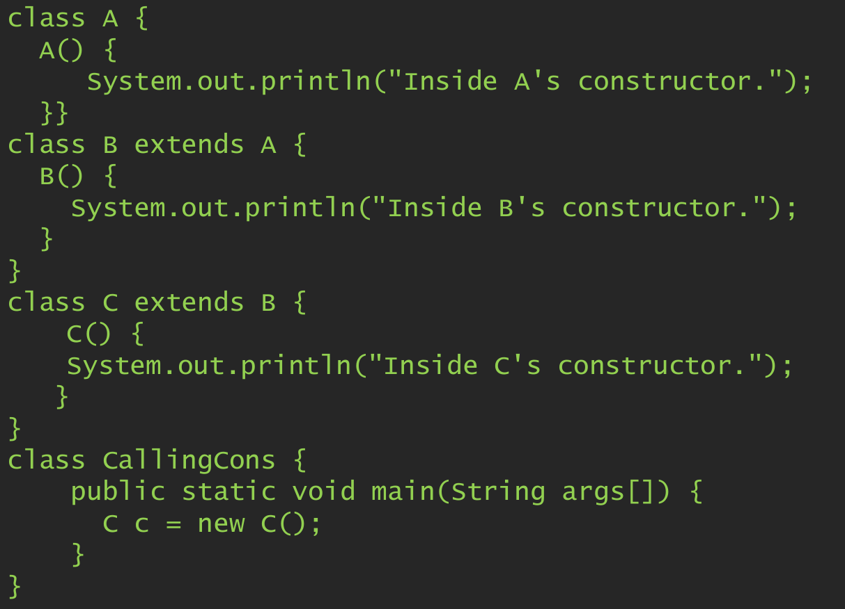
Constructors in class hierarchy

Slide 16
Contd.
Output:
Inside A’s constructor
Inside B’s constructor
Inside C’s constructor

Slide 17
Overriding – revisiting polymorphism
Overriding is another way of achieving polymorphism in java.
Overriding refers to method in a subclass having the same name and type signature as a method in its superclass, then the method in the subclass is said to override the method in the superclass.

Slide 18
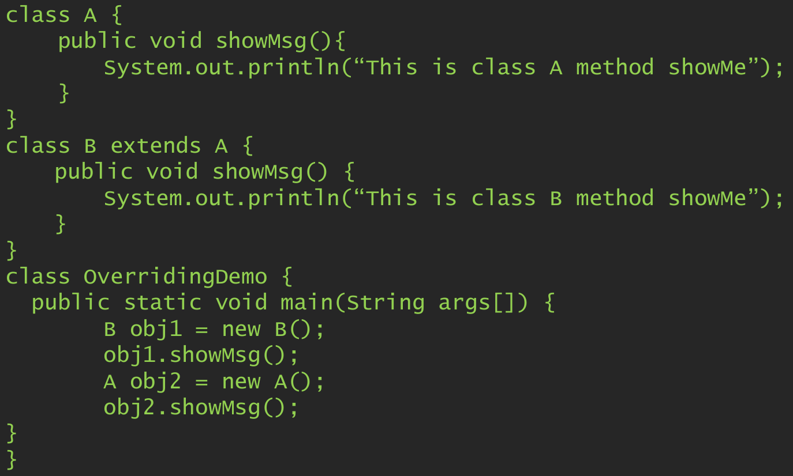
Overriding Example code

Slide 19
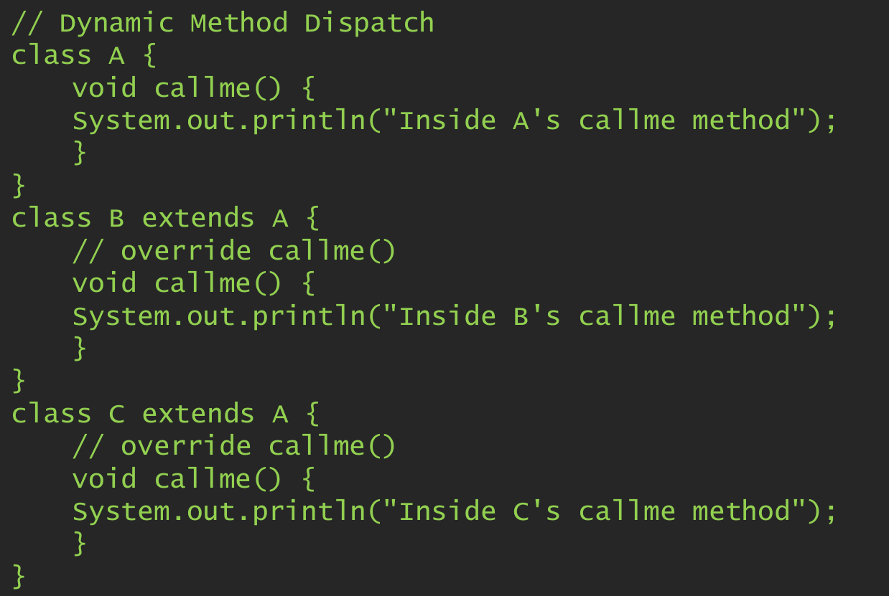
Dynamic method dispatch

Slide 20
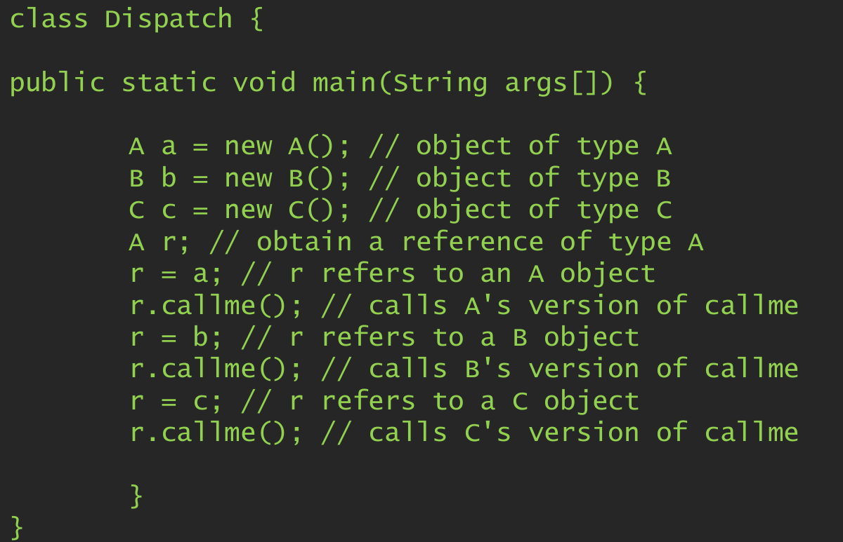
Dynamic method dispatch

Slide 21
Abstract classes
Abstract methods are method declarations without the body (actual implementation) of the method.
Class that contains one or more abstract methods must also be declared abstract
To declare a class abstract, you simply use the abstract keyword in front of the class keyword at the beginning of the class declaration.
You cannot declare abstract constructors, or abstract static methods.
Subclass of an abstract class must either implement all of the abstract methods in the superclass, or be itself declared abstract.

Slide 22
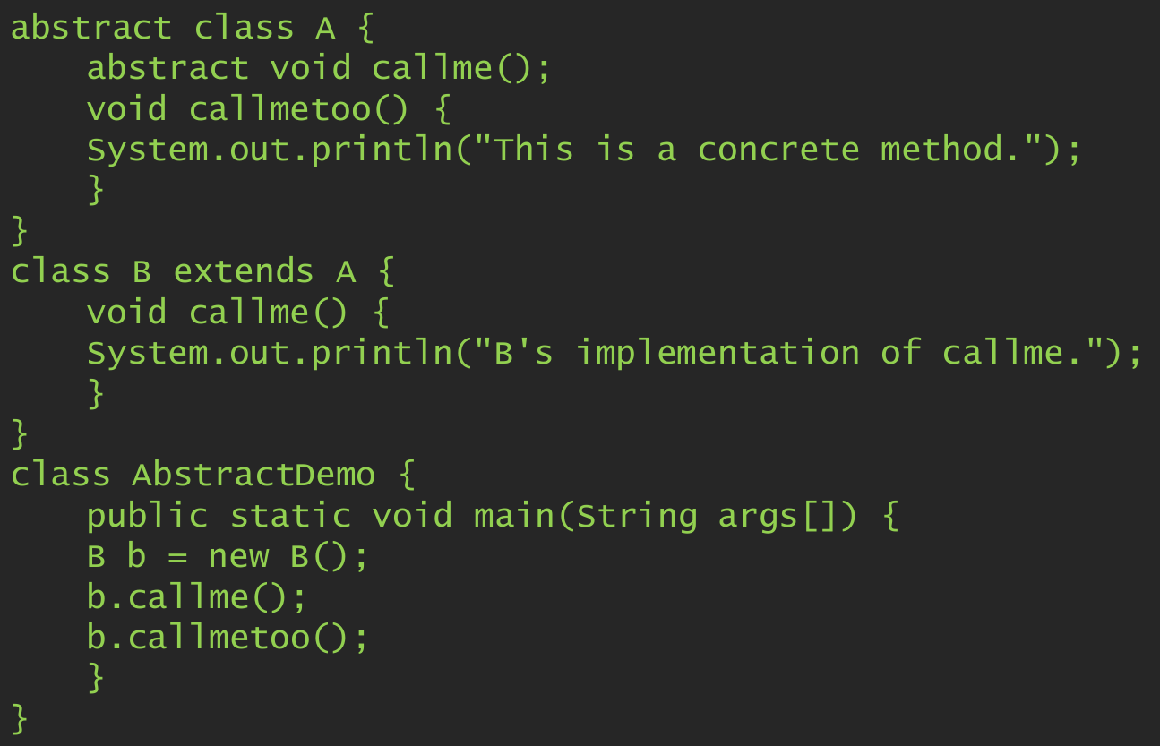
Abstract classes –example code

Slide 23
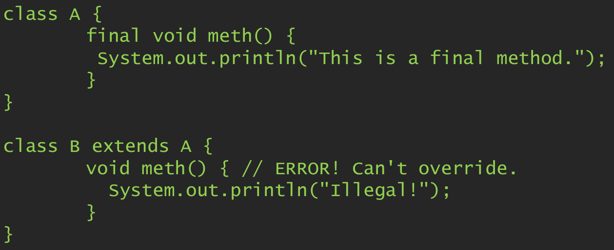
Using final to prevent overriding
To stop a method from being overridden, specify final as a modifier at the start of its declaration.
Methods declared as final cannot be overridden.

Slide 24
Using final to prevent inheritance
To prevent a class from being inherited, it is declared as final.
Declaring a class as final implicitly declares all of its methods as final, too.
final class A {
// ...
}
// The following class is illegal.
class B extends A { // ERROR! Can't subclass A
// ...
}

Slide 25
THANK YOU!

